Slide 1
Introduction to Neural Network

Slide 2
Artificial Neural Networks
Artificial neural networks attempt to simplify and mimic this brain behavior.
They can be trained in a supervised or unsupervised manner.
In a supervised ANN, the network is trained by providing matched input and output data samples, with the intention of getting the ANN to provide a desired output for a given input.
An example is an e-mail spam filter – the input training data could be the count of various words in the body of the e-mail, and the output training data would be a classification of whether the e-mail was truly spam or not.
If many examples of e-mails are passed through the neural network this allows the network to learn what input data makes it likely that an e-mail is spam or not.
This learning takes place be adjusting the weights of the ANN connections, but this will be discussed further in the next section.
Unsupervised learning in an ANN is an attempt to get the ANN to “understand” the structure of the provided input data “on its own”. This type of ANN will not be discussed in this post

Slide 3
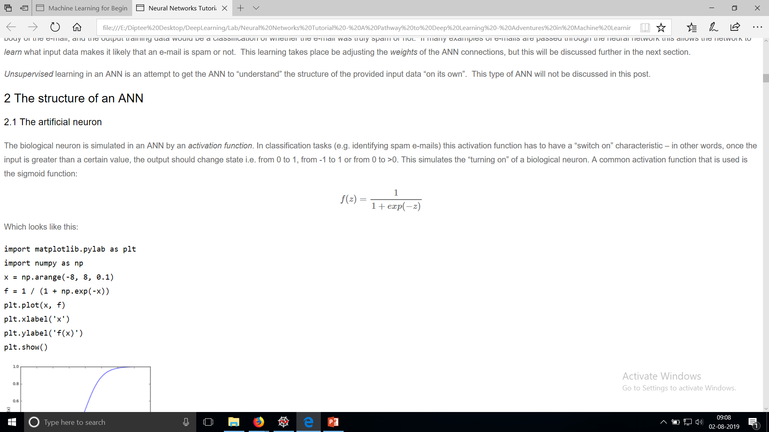
The structure of an ANN-The artificial neuron
The biological neuron is simulated in an ANN by an activation function. In classification tasks (e.g. identifying spam e-mails) this activation function has to have a “switch on” characteristic – in other words, once the input is greater than a certain value, the output should change state i.e. from 0 to 1, from -1 to 1 or from 0 to >0.
This simulates the “turning on” of a biological neuron.
A common activation function that is used is the sigmoid function

Slide 4
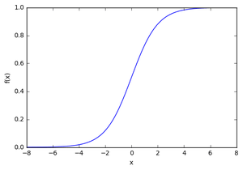
The structure of an ANN-The artificial neuron
import matplotlib.pylab as plt
import numpy as np
x = np.arange(-8, 8, 0.1)
f = 1 / (1 + np.exp(-x))
plt.plot(x, f)
plt.xlabel('x')
plt.ylabel('f(x)')
plt.show()
As can be seen in the figure above, the function is “activated” i.e. it moves from 0 to 1 when the input x is greater than a certain value. The sigmoid function isn’t a step function however, the edge is “soft”, and the output doesn’t change instantaneously

Slide 5
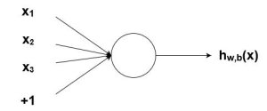
Nodes
As mentioned previously, biological neurons are connected hierarchical networks, with the outputs of some neurons being the inputs to others.
We can represent these networks as connected layers of nodes.
Each node takes multiple weighted inputs, applies the activation function to the summation of these inputs, and in doing so generates an output.
This will break this down further, but to help things along, consider the diagram below:
Figure 2. Node with inputs

Slide 6
Nodes
The circle in the image above represents the node.
The node is the “seat” of the activation function, and takes the weighted inputs, sums them, then inputs them to the activation function.
The output of the activation function is shown as h in the above diagram.
Note: a node as I have shown above is also called a perceptron in some literature.
What about this “weight” idea that has been mentioned?
The weights are real valued numbers (i.e. not binary 1s or 0s), which are multiplied by the inputs and then summed up in the node. So, in other words, the weighted input to the node above would be:
x1w1+x2w2+x3w3+b

Slide 7
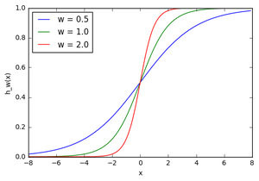
Effect of adjusting weights
w1 = 0.5
w2 = 1.0
w3 = 2.0
l1 = 'w = 0.5'
l2 = 'w = 1.0'
l3 = 'w = 2.0'
for w, l in [(w1, l1), (w2, l2), (w3, l3)]:
f = 1 / (1 + np.exp(-x*w))
plt.plot(x, f, label=l)
plt.xlabel('x')
plt.ylabel('h_w(x)')
plt.legend(loc=2)
plt.show()
Figure 4. Effect of adjusting weights

Slide 8

The bias
Let’s take an extremely simple node, with only one input and one output:
The input to the activation function of the node in this case is simply x1w1x1w1 . What does changing w1w1 do in this simple network?

Slide 9
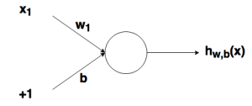
The Bias
Here we can see that changing the weight changes the slope of the output of the sigmoid activation function, which is obviously useful if we want to model different strengths of relationships between the input and output variables.
However, what if we only want the output to change when x is greater than 1?
This is where the bias comes in – let’s consider the same network with a bias input:
Figure . Effect of bias

Slide 10
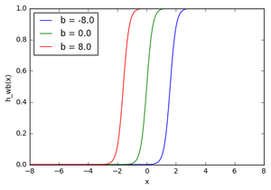
Bias
w = 5.0
b1 = -8.0
b2 = 0.0
b3 = 8.0
l1 = 'b = -8.0'
l2 = 'b = 0.0'
l3 = 'b = 8.0'
for b, l in [(b1, l1), (b2, l2), (b3, l3)]:
f = 1 / (1 + np.exp(-(x*w+b)))
plt.plot(x, f, label=l)
plt.xlabel('x')
plt.ylabel('h_wb(x)')
plt.legend(loc=2)
plt.show()
Figure . Effect of bias adjustments

Slide 11
Bias
In this case, the w1w1 has been increased to simulate a more defined “turn on” function.
As you can see, by varying the bias “weight” bb , you can change when the node activates.
Therefore, by adding a bias term, you can make the node simulate a generic if function, i.e. if (x > z) then 1 else 0.
Without a bias term, you are unable to vary the z in that if statement, it will be always stuck around 0.
This is obviously very useful if you are trying to simulate conditional relationships.

Slide 12
Putting together the structure
Hopefully the previous explanations have given you a good overview of how a given node/neuron/perceptron in a neural network operates.
However, as you are probably aware, there are many such interconnected nodes in a fully fledged neural network.
These structures can come in a myriad of different forms, but the most common simple neural network structure consists of an input layer, a hidden layer and an output layer.
An example of such a structure can be seen below:
Figure . Three layer neural network

Slide 13
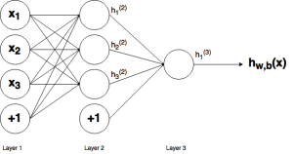

Slide 14
Putting together the structure
The three layers of the network can be seen in the above figure – Layer 1 represents the input layer, where the external input data enters the network.
Layer 2 is called the hidden layer as this layer is not part of the input or output.
Note: neural networks can have many hidden layers, but in this case for simplicity I have just included one.
Finally, Layer 3 is the output layer. You can observe the many connections between the layers, in particular between Layer 1 (L1) and Layer 2 (L2).
As can be seen, each node in L1 has a connection to all the nodes in L2. Likewise for the nodes in L2 to the single output node L3.
Each of these connections will have an associated weight.

Slide 15
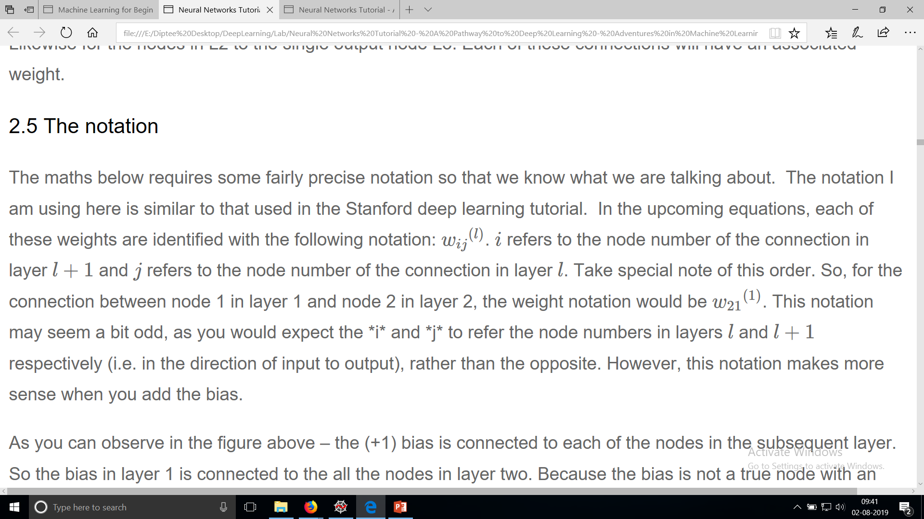
Notations

Slide 16
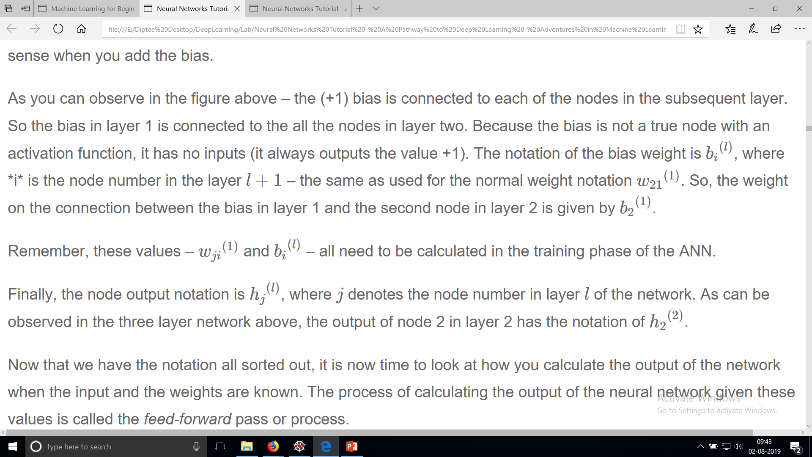
Notation

Slide 17
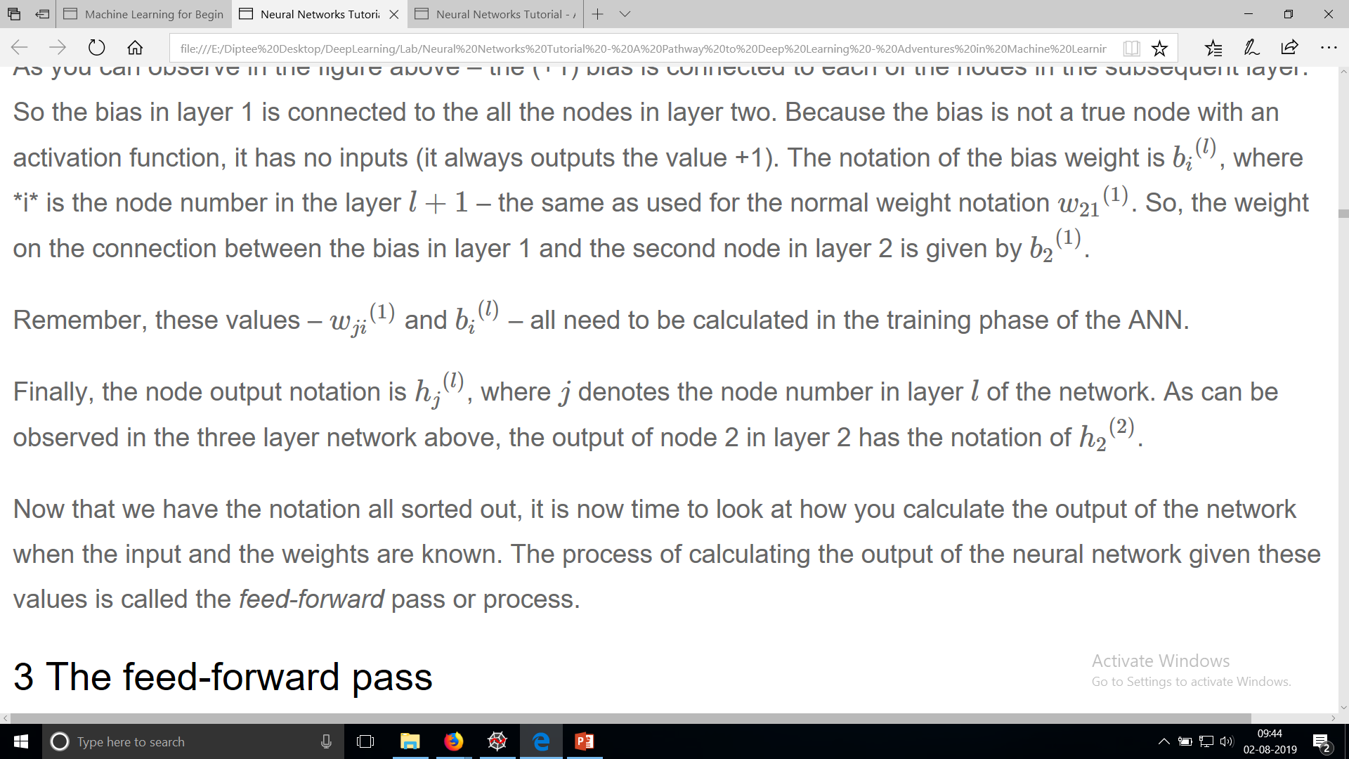
Notation

Slide 18
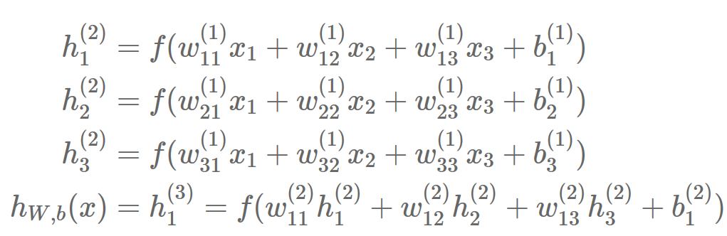
The feed-forward pass
To demonstrate how to calculate the output from the input in neural networks, let’s start with the specific case of the three layer neural network that was presented above.
Below it is presented in equation form, then it will be demonstrated with a concrete example and some Python code:

Slide 19
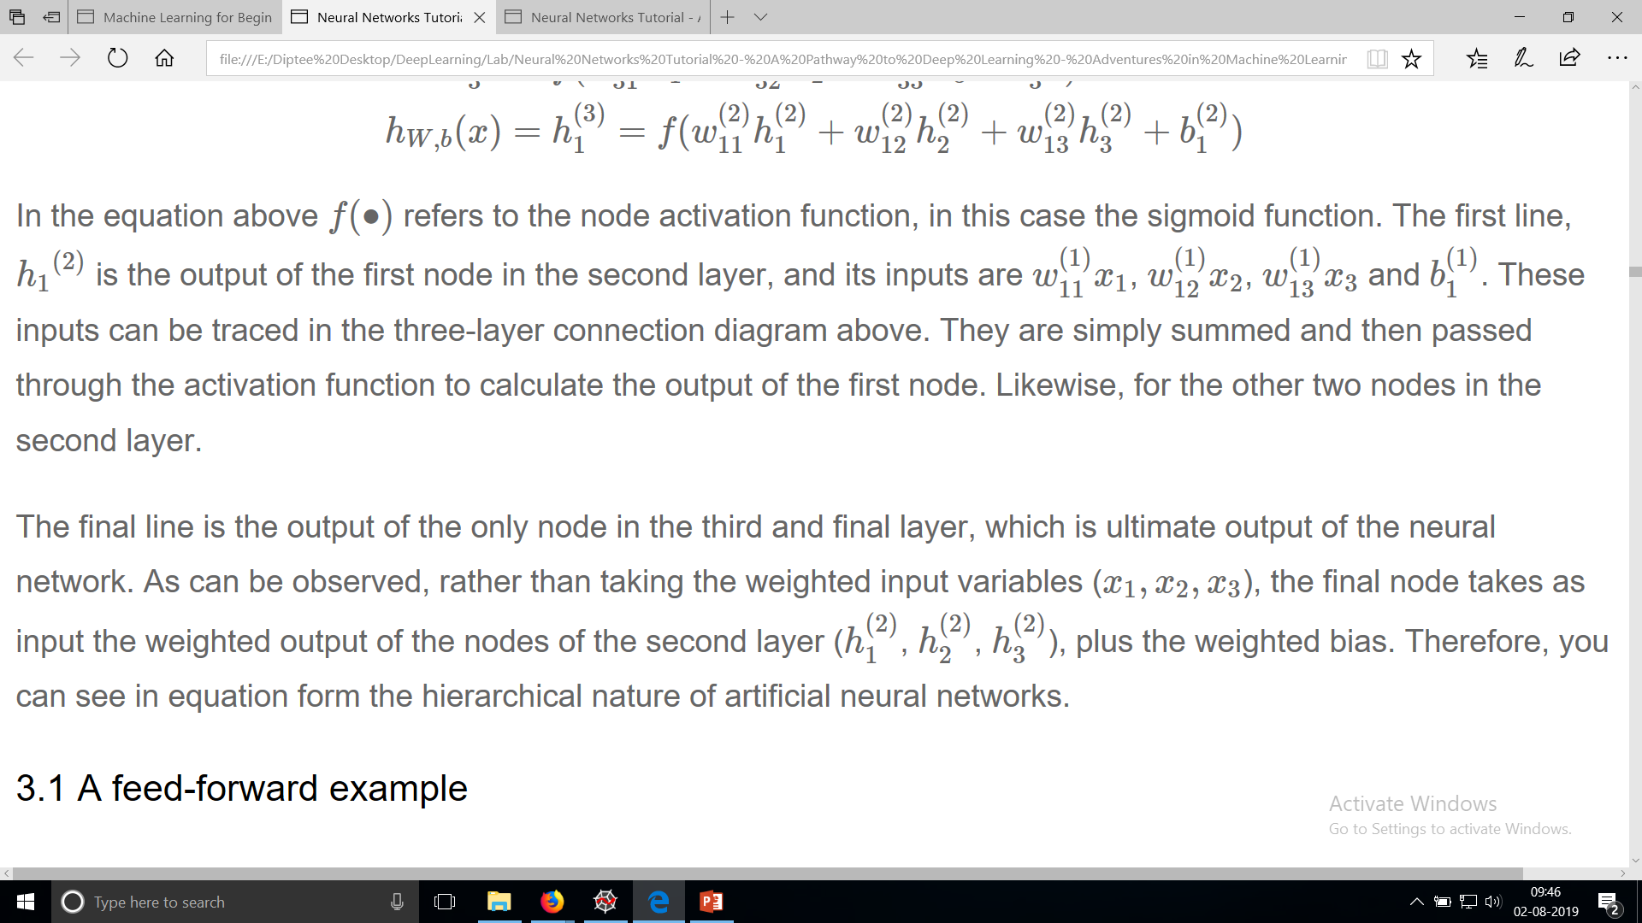
The feed-forward pass

Slide 20
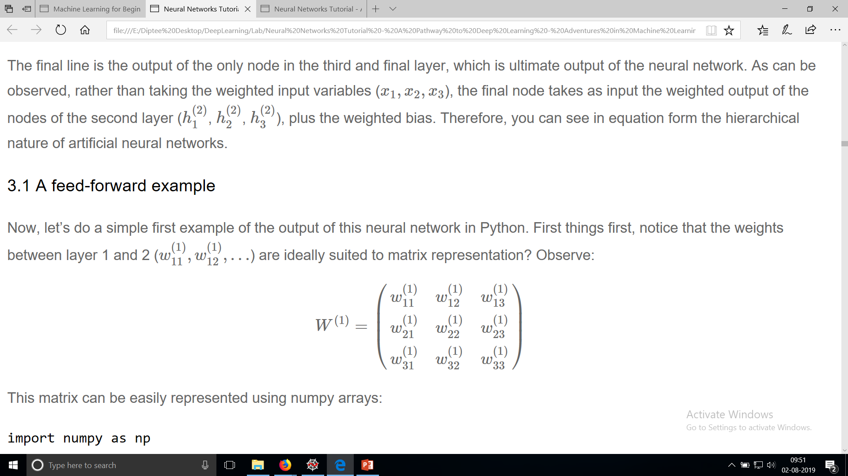
A feed-forward example

Slide 21
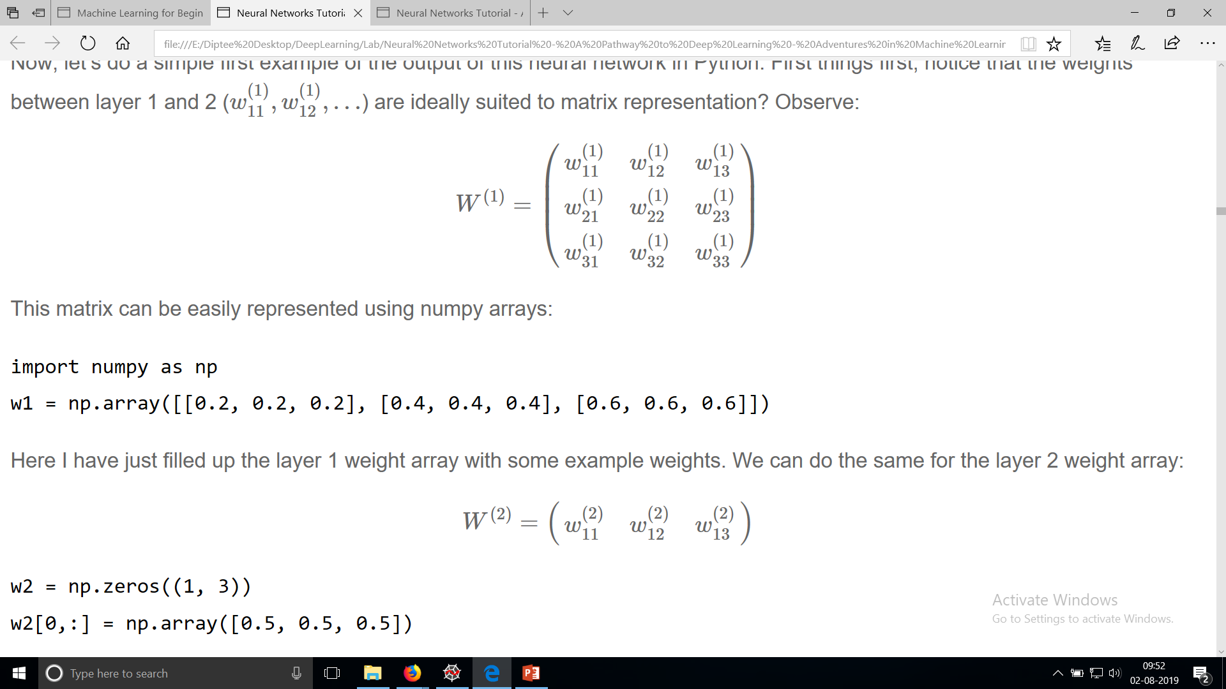
A feed-forward example

Slide 22
A feed-forward example
We can also setup some dummy values in the layer 1 bias weight array/vector, and the layer 2 bias weight (which is only a single value in this neural network structure – i.e. a scalar):
b1 = np.array([0.8, 0.8, 0.8])
b2 = np.array([0.2])

Slide 23
def simple_looped_nn_calc(n_layers, x, w, b):
for l in range(n_layers-1):
#Setup the input array which the weights will be multiplied by for each layer
#If it's the first layer, the input array will be the x input vector
#If it's not the first layer, the input to the next layer will be the
#output of the previous layer
if l == 0:
node_in = x
else:
node_in = h
#Setup the output array for the nodes in layer l + 1
h = np.zeros((w[l].shape[0],))
#loop through the rows of the weight array
for i in range(w[l].shape[0]):
#setup the sum inside the activation function
f_sum = 0
#loop through the columns of the weight array
for j in range(w[l].shape[1]):
f_sum += w[l][i][j] * node_in[j]
#add the bias
f_sum += b[l][i]
#finally use the activation function to calculate the i-th output i.e. h1, h2, h3
h[i] = f(f_sum)
return h

Slide 24
def simple_looped_nn_calc(n_layers, x, w, b):
for l in range(n_layers-1):
#Setup the input array which the weights will be multiplied by for each layer
#If it's the first layer, the input array will be the x input vector
#If it's not the first layer, the input to the next layer will be the
#output of the previous layer
if l == 0:
node_in = x
else:
node_in = h
#Setup the output array for the nodes in layer l + 1
h = np.zeros((w[l].shape[0],))

Slide 25
#loop through the rows of the weight array
for i in range(w[l].shape[0]):
#setup the sum inside the activation function
f_sum = 0
#loop through the columns of the weight array
for j in range(w[l].shape[1]):
f_sum += w[l][i][j] * node_in[j]
#add the bias
f_sum += b[l][i]
#finally use the activation function to calculate the i-th output i.e. h1, h2, h3
h[i] = f(f_sum)
return h

Slide 26
This function takes as input the number of layers in the neural network, the x input array/vector, then Python tuples or lists of the weights and bias weights of the network, with each element in the tuple/list representing a layer
in the network. In other words, the inputs are setup in the following:
w = [w1, w2]
b = [b1, b2]
#a dummy x input vector
x = [1.5, 2.0, 3.0]
The function first checks what the input is to the layer of nodes/weights being considered.
If we are looking at the first layer, the input to the second layer nodes is the input vector x multiplied by the relevant weights. After the first layer though, the inputs to subsequent layers are the output of the previous layers.
Finally, there is a nested loop through the relevant I and j values of the weight vectors and the bias. The function uses the dimensions of the weights for each layer to figure out the number of nodes and therefore the structure of the network.

Slide 27
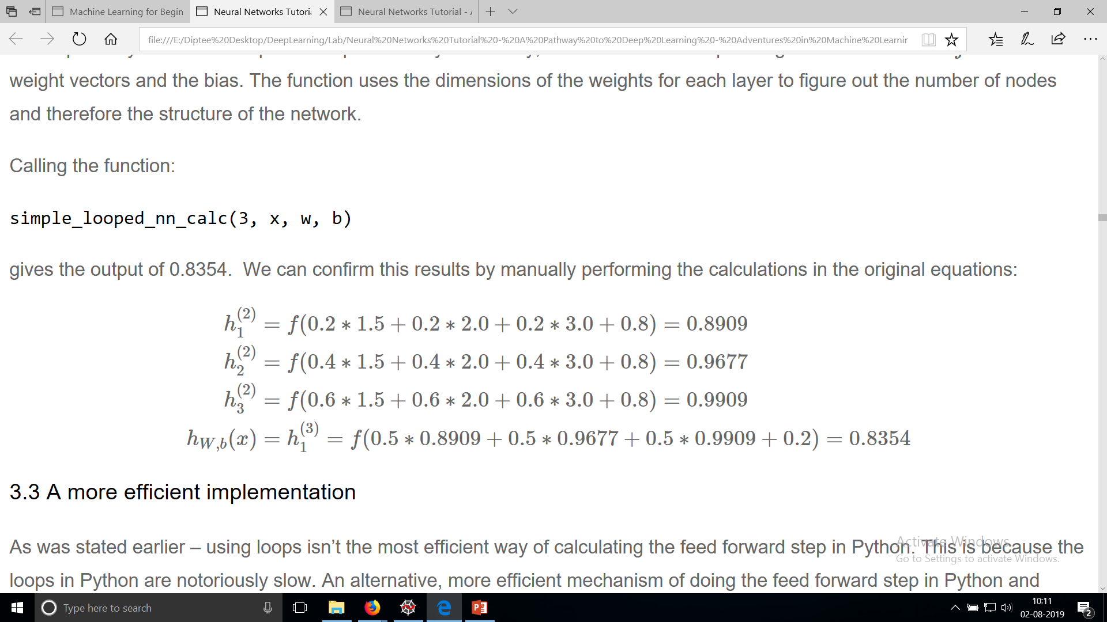

Slide 28
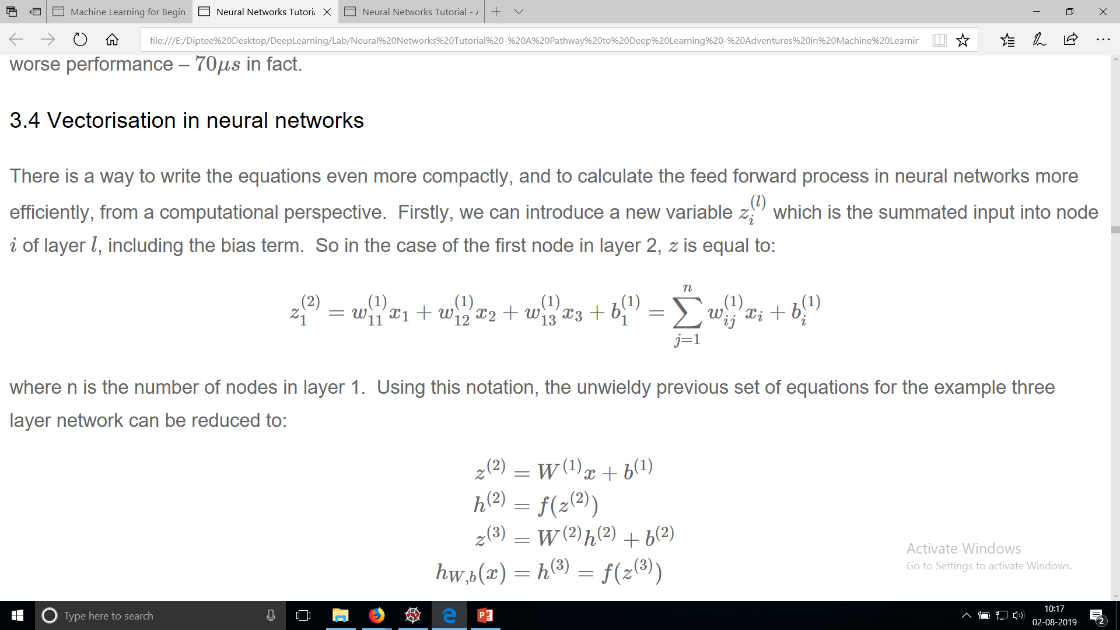
Vectorisation in neural networks

Slide 29
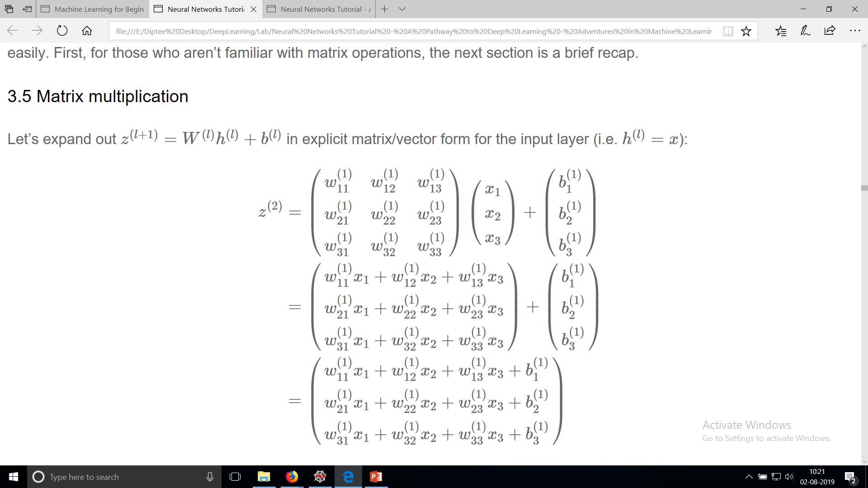
Matrix Multiplication

Slide 31
You can observe how each row of the final result above corresponds to the argument of the activation function in the original non-matrix set of equations above.
If the activation function is capable of being applied element-wise (i.e. to each row separately in the z(1)z(1) vector), then we can do all our calculations using matrices and vectors rather than slow Python loops.
numpy allows us to do just that, with reasonably fast matrix operations and element-wise functions.
Let’s have a look at a much more simplified (and faster) version of the simple_looped_nn_calc:

Slide 32
def matrix_feed_forward_calc(n_layers, x, w, b):
for l in range(n_layers-1):
if l == 0:
node_in = x
else:
node_in = h
z = w[l].dot(node_in) + b[l]
h = f(z)
return h

Slide 33
There are 2 algorithms in Neural networks
1.Forward propagation.
2.Back propagation.

Slide 34
